Slide 2
Complete (clinical) response in rectal cancer: the oncologist’s perspective
the clinical complete response
is every oncologist’s and every rectal cancer patient's goal!
(no surgery = organ preservation)

Slide 4
MMRd/MSI-H
(~ 3%)
Gandini A, Cancers 2025

Slide 5
Complete (clinical) response in rectal cancer: the oncologist’s perspective
How to get it
How to assess it
How to manage it

Slide 6
Complete (clinical) response in rectal cancer … after neoadjuvant tratment
OXA-CTRT pre-op
JCO2011; JCO2012; JCO2014
TNT vs CTRT pre-op
Lancet Oncol 2020; Lancet Oncol 2021
Immunotherapy MSI-H
NEJM 2022
Pre-op shortRT
NEJM 1997
Pre-op vs post-op CTRT
NEJM 2004
1990
1997-2001
2004
2012
2011-2014
2015-2020
2020-2021
2019 & 2021
2022
2022
NIH Consensus Conference
JAMA 1990
Pre-op shortRT vs CTRT
JCO 2012
OXA pre e post-op
LancetOncol 2015; JCO 2020
induction vs consolidation
JCO 2019 & JAMA Oncol 2021
Short vs LC RT for consolidation strategy
JCO 2022
Pre-op shortRT + TME
NEJM 2001

Slide 7
Complete (clinical) response in rectal cancer … after immunotherapy
Cercek A, NEJM 2022

Slide 8
Complete (clinical) response in rectal cancer … after immunotherapy
cCR (75–100 %) / pCR (47.6–75.9 %)
Petrelli F et al, Crit Rev in Oncol/hematol 2025

Slide 10
Complete response in rectal cancer after neoadjuvant CT(± oxali)RT
trial | Neoadj Treat | Primary aim | Primary result | NOM | pCR (%)
STAR¹ | CTRT no Oxali | 3y OS | never reported | Surgery mandatory | 16
 | CTRT Oxali |  |  | Surgery mandatory | 16
ACCORD² | CTRT no Oxali | pCR | 13,9 % | Surgery mandatory | 14
 | CTRT Oxali | (p = 0,09) | 19,2 % | Surgery mandatory | 19
NSABP³ | CTRT no Oxali | 3 y loc rec | 12,1 % | Surgery mandatory | 17,8
 | CTRT Oxali | (p= n.s.) | 11,2 % | Surgery mandatory | 19,5
German⁴ | CTRT no Oxali | DFS | HR = 0,79 | Surgery mandatory | 13
 | CTRT Oxali | (p= 0,03) |  | Surgery mandatory | 17
PETACC6⁵ | CTRT no Oxali | 3y DFS | 71,3% | Surgery mandatory | 11,6
 | CTRT Oxali | (p= n.s.) | 70,5% | Surgery mandatory | 14
PROSPECT⁶ | Chemio alone | DFS | HR = 0,92 | Surgery mandatory | 21,9
 | CTRT | Non-inferior | not met | Surgery mandatory | 24,3
FORWAK⁷ | CTRT no oxali | 3y DFS | 72,9 % | Surgery mandatory | 14,0
 | CTRT Oxali | p= n.s. | 77,2% | Surgery mandatory | 27,5
 | Chemio alone |  | 73,5% | Surgery mandatory | 6,6
15-20%
¹Aschele C, JCO 2011; ²Gerard JP, JCO 2010 & JCO 2012; ³O’Connell MJ, JCO 2014; ⁴Roedel C, Lancet Oncol 2012; ⁵Schmoll J, JCO 2020; ⁶Schrag D, NEJM 2023; ⁷Deng Y, JCO 2016;

Slide 11
Complete response in rectal cancer after neoadjuvant CT(± oxali)RT
trial | Neoadj Treat | Primary aim | Primary result | NOM | pCR (%)
STAR¹ | CTRT no Oxali | 3y OS | never reported | Surgery mandatory | 16
 | CTRT Oxali |  |  | Surgery mandatory | 16
ACCORD² | CTRT no Oxali | pCR | 13,9 % | Surgery mandatory | 14
 | CTRT Oxali | (p = 0,09) | 19,2 % | Surgery mandatory | 19
NSABP³ | CTRT no Oxali | 3 y loc rec | 12,1 % | Surgery mandatory | 17,8
 | CTRT Oxali | (p= n.s.) | 11,2 % | Surgery mandatory | 19,5
German⁴ | CTRT no Oxali | DFS | HR = 0,79 | Surgery mandatory | 13
 | CTRT Oxali | (p= 0,03) |  | Surgery mandatory | 17
PETACC6⁵ | CTRT no Oxali | 3y DFS | 71,3% | Surgery mandatory | 11,6
 | CTRT Oxali | (p= n.s.) | 70,5% | Surgery mandatory | 14
PROSPECT⁶ | Chemio alone | DFS | HR = 0,92 | Surgery mandatory | 21,9
 | CTRT | Non-inferior | not met | Surgery mandatory | 24,3
FORWAK⁷ | CTRT no oxali | 3y DFS | 72,9 % | Surgery mandatory | 14,0
 | CTRT Oxali | p= n.s. | 77,2% | Surgery mandatory | 27,5
 | Chemio alone |  | 73,5% | Surgery mandatory | 6,6
CONVERT⁸ | CTRT (no oxali) | 3y local rec free | HR = 1,40 | Surgery mandatory
 | Chemio (oxali) | Non-inferior | not met | Surgery mandatory
¹Aschele C, JCO 2011; ²Gerard JP, JCO 2010 & JCO 2012; ³O’Connell MJ, JCO 2014; ⁴Roedel C, Lancet Oncol 2012; ⁵Schmoll J, JCO 2020; ⁶Schrag D, NEJM 2023; ⁷Deng Y, JCO 2016; ⁸Mei W-J , JCO 2026

Slide 12
Complete response in rectal cancer after neoadjuvant TNT
trial | Neoadj Treat | N. pts | Primary aim | cCR (%) | NOM | pCR (%) | Organ preservation at 3 yrs
CAO/ARO/AIO-12¹ | TNT-induction | 158 | pCR | - | Surgery mandatory | 17
 | TNT- consolidation | 153 |  | - | Surgery mandatory | 25
RAPIDO² | CTRT | 450 | 3y DFS | - | Surgery mandatory | 14,3
 | TNT – consolidation (+ shortRT) | 462 | HR= 0,75 (p= 0.019) | - | Surgery mandatory | 28,4
PRODIGE³ | CTRT | 230 | DFS | - | Surgery mandatory | 12,1
 | TNT – induction (+ CTRT) | 231 | HR= 0,69 (p= 0.034) | - | Surgery mandatory | 27,8
STELLAR⁴ | CTRT | 297 | 3y DFS | 4,4 | Surgery mandatory | 12,3
 | TNT – consolidation (+ shortRT) | 302 | (p= n.s.) | 11,1 | Surgery mandatory | 21,8
POLISH⁵ | CTRT | 254 | R0 | - | Surgery mandatory | 12
 | TNT – consolidation (+ shortRT) | 261 | (p= n.s.) | - | Surgery mandatory | 16
¹Fokas E, JCO 2019; ²Bahadoer RR, LancetOncol 2020; ³Conroy T, LancetOncol 2021; ⁴Garcia-Aguilar J, JCO 2022; ⁵Jin J, JCO 2022;

Slide 13
Complete response in rectal cancer after neoadjuvant TNT
trial | Neoadj Treat | N. pts | Primary aim | cCR (%) | NOM | pCR (%) | Organ preservation at 3 yrs
CAO/ARO/AIO-12¹ | TNT-induction | 158 | pCR | - | Surgery mandatory | 17
 | TNT- consolidation | 153 |  | - | Surgery mandatory | 25
RAPIDO² | CTRT | 450 | 3y DFS | - | Surgery mandatory | 14,3
 | TNT – consolidation (+ shortRT) | 462 | HR= 0,75 (p= 0.019) | - | Surgery mandatory | 28,4
PRODIGE³ | CTRT | 230 | DFS | - | Surgery mandatory | 12,1
 | TNT – induction (+ CTRT) | 231 | HR= 0,69 (p= 0.034) | - | Surgery mandatory | 27,8
STELLAR⁴ | CTRT | 297 | 3y DFS | 4,4 | Surgery mandatory | 12,3
 | TNT – consolidation (+ shortRT) | 302 | (p= n.s.) | 11,1 | Surgery mandatory | 21,8
POLISH⁵ | CTRT | 254 | R0 | - | Surgery mandatory | 12
 | TNT – consolidation (+ shortRT) | 261 | (p= n.s.) | - | Surgery mandatory | 16
OPRA⁶ | CTRT + consolidation | 166 | DFS | 44 | 76% |  | 53%
 | CTRT + induction | 158 | (p = n.s.) | 56 | 71% |  | 41%
¹Fokas E, JCO 2019; ²Bahadoer RR, LancetOncol 2020; ³Conroy T, LancetOncol 2021; ⁴Garcia-Aguilar J, JCO 2022; ⁵Jin J, JCO 2022; ⁶Thompson HM, JAMA network 2024

Slide 14
Complete (clinical) response in rectal cancer managed with W&W - registry
Local regrowth = 24%
Global distant mets = 8%
Distant mets in loc regrowth = 18%
5y cancer-specific OS = 93·8%
5y OS = 84·7%
IWWD, Lancet 2018

Slide 15
Complete (clinical) response in rectal cancer managed with W&W – italian noCUT phase II trial
XELOX (4 cycles) → CTRT
cCR → NOM
primary endpoint =
30-month distant relapse-free survival after NOM
No cCR→ surgery
cCR = 26% (NOM)
pCR = 8%
30 m DRFS = 95%
NOM
30 m DRFS = 74%
surgery
30 m DRFS = 74%
all
Exploratory prognostic role of ctDNA
Loc regrowth = 17%
NOM
Loc Rec = 16%
surgery
Amatu A, Lancet Oncol 2025

Slide 16
Complete (clinical) response in rectal cancer managed with W&W

Slide 17
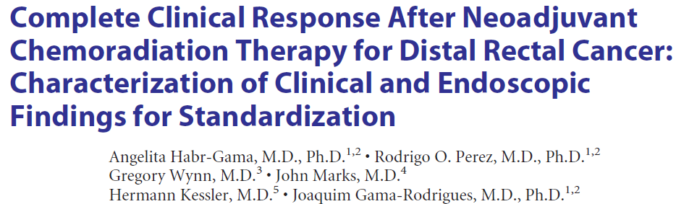
Complete (clinical) response in rectal cancer: how to assess it
Criteria to define (or exclude) initial (8 wks after Rand) clinical complete response
No mass/nodules
No ulcer/mucosal irregularity
No significant stenosis
Whitening of the mucosa
Theleangectasia
Loss of pliability

Slide 18
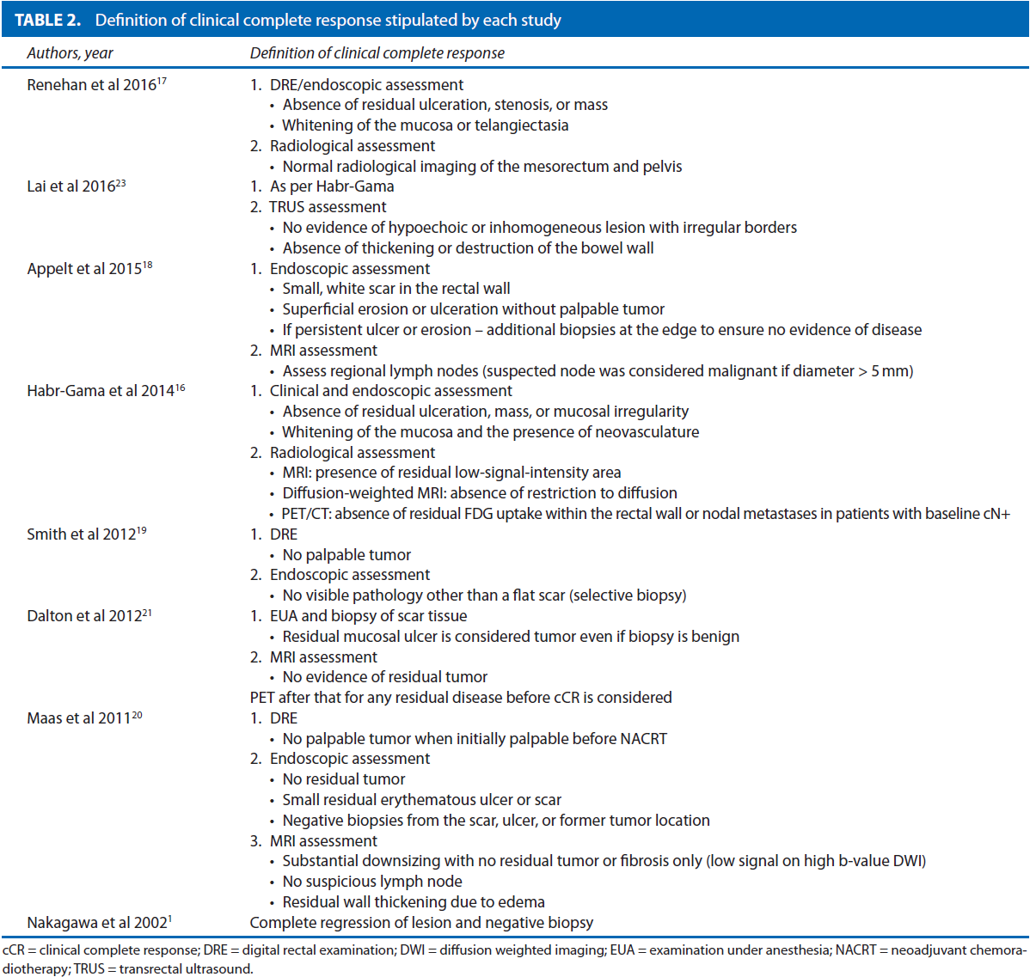
Review: Kong JC et al, Dis Colon Rectum 2017
D
E
F
I
N
I
N
G
cCR

Slide 19
Complete (clinical) response in rectal cancer: how to assess it
Cercek A, Clin Colorectal Cancer 2025
ESMO Guidelines AnnOncol 2025
https://doi.org/10.1016/j.annonc.2025.05.528
Fokas M, Nat Rev Clin Oncol 2021

Slide 20
Complete (clinical) response in rectal cancer: when to assess it
Pooled analysis of 3085 individual patient data enrolled in 7 international randomized trials: CAO/ARO/AIO-94, EORTC22921, FFCD9203, ACCORD12/0405, CAO-AROAIO-04, TROG 01.04 and INTERACT-LEADER
28,6%
Gambacorta MA …. Valentini V, Radiother & Oncol 2020
Habr-Gama A, et al, Dis Colon Rectum 2019
12,2%
10,2%
12,2%

Slide 21
Complete (clinical) response in rectal cancer: when to assess it
For patients interested in organ preservation, a first reassessment of tumour response could be considered 8-12 weeks after CRT completion, even though systemic consolidation ChT is ongoing.
While most patients will not achieve a cCR by 8-12 weeks after CRT, a second reassessment of tumour response is allowed in another 8-12 weeks.
Most patients achieve a cCR within 24-26 weeks from neoadjuvant CRT completion, allowing them to enter a surveillance programme.
ESMO Guidelines AnnOncol 2025
https://doi.org/10.1016/j.annonc.2025.05.528

Slide 22
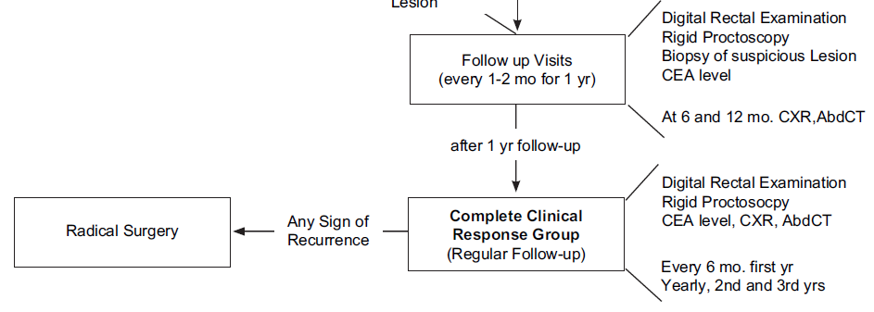
Complete (clinical) response in rectal cancer: how to manage it
Habr-Gama A, Int J Rad Biol Phys 2008

Slide 23
Complete (clinical) response in rectal cancer: how to manage it
Intensive follow up:
  DRE every 3 months for 2 yrs, then every 6 months for 3 yrs
  Endoscopy (retto-sigmoid) every 3 months for 2 yrs, then every 6 months for 3 yrs
  Biopsy is suspicion of regrowth
  Pelvic MRI every 3 months for 2 yrs, then every 6 months for 3 yrs
  TB CT scan every 6 months y 1, then annually y 2-5
ESMO Guidelines AnnOncol 2025
https://doi.org/10.1016/j.annonc.2025.05.528

Slide 24
Is local regrowth just a matter of
salvage surgery?
to compare the risk of DM between patients with LR after W&W (IWWD registry) and patients with near-pCR managed by TME at the time of reassessment of response (Spanish registry)
Fernandez LM, J Clin Oncol 2024

Slide 25
Complete (clinical) response in rectal cancer: conclusions
How to get it = multimodality treatment (TNT-consolidation); ICI
How to assess it = MRI + endoscopy/DRE (is it enough?)
How to manage it = intensive follow up
The future:
Increase cCR
Improve cCR assessment
Standardize cCR assessment
Refine prognostic features for W&W approach

Slide 26
Complete response in rectal cancer after neoadjuvant TNT
trial | Neoadj Treat | cCR (%) | NOM | pCR (%)
STAR¹ | CTRT no Oxali | - | Surgery mandatory | 16
 | CTRT Oxali | - | Surgery mandatory | 16
ACCORD² | CTRT no Oxali | - | Surgery mandatory | 14
 | CTRT Oxali | - | Surgery mandatory | 19
NSABP³ | CTRT no Oxali | - | Surgery mandatory | 17,8
 | CTRT Oxali | - | Surgery mandatory | 19,5
German⁴ | CTRT no Oxali | - | Surgery mandatory | 13
 | CTRT Oxali | - | Surgery mandatory | 17
PETACC6⁵ | CTRT no Oxali | - | Surgery mandatory | 11,6
 | CTRT Oxali | - | Surgery mandatory | 14
CAO/ARO/AIO-12⁶ | TNT-induction | 3,8 | Surgery mandatory – 3,8 | 17
 | TNT- consolidation | 2,7 | Surgery mandatory – 2,7 | 25
RAPIDO⁷ | CTRT | - | Surgery mandatory – 2,4 | 14,3
 | TNT – consolidation (+ short) | - | Surgery mandatory – 3,0 | 28,4
PRODIGE⁸ | CTRT | - | Surgery mandatory | 12,1
 | TNT – induction (+ CTRT) | - | Surgery mandatory | 27,8
OPRA⁹ | CTRT + consolidation |  | 76
 | CTRT + induction |  | 71
1Aschele C, JCO 2011; 2Gerard JP, JCO 2010 & JCO 2012; 3O’Connell MJ, JCO 2014; 4Roedel C, Lancet Oncol 2012;5Schmoll J; 6Fokas E, JCO 2019; 7Bahadoer RR, LancetOncol 2020; 8Conroy T, LancetOncol 2021;

Slide 27
Complete (clinical) response in rectal cancer … after immunotherapy
Petrelli F et al, Crit Rev in Oncol/hematol 2025

Slide 28
Complete response in rectal cancer after neoadjuvant TNT
trial | Neoadj Treat | N. pts | Primart aim | cCR (%) | NOM | pCR (%) | Organ preservation at 3 yrs
CAO/ARO/AIO-12¹ | TNT-induction |  |  | - | Surgery mandatory – 3,8 | 17
 | TNT- consolidation |  |  | - | Surgery mandatory – 2,7 | 25
RAPIDO² | CTRT |  |  | - | Surgery mandatory – 2,4 | 14,3
 | TNT – consolidation (+ shortRT) |  |  | - | Surgery mandatory – 3,0 | 28,4
PRODIGE³ | CTRT |  |  | - | Surgery mandatory | 12,1
 | TNT – induction (+ CTRT) |  |  | - | Surgery mandatory | 27,8
STELLAR⁴ | CTRT |  |  | 4,4 | Surgery mandatory | 12,3
 | TNT – consolidation (+ shortRT) |  |  | 11,1 | Surgery mandatory | 21,8
POLISH⁵
OPRA⁶ | CTRT + consolidation |  |  | 44 | 76% |  | 53%
 | CTRT + induction |  |  | 56 | 71% |  | 41%
¹Fokas E, JCO 2019; ²Bahadoer RR, LancetOncol 2020; ³Conroy T, LancetOncol 2021; ⁴Garcia-Aguilar J, JCO 2022; ⁵Jin J, JCO 2022; ⁶Thompson HM, JAMA network 2024

Slide 29
Complete (clinical) response in rectal cancer … after neoadjuvant CTRT or TNT

Slide 30
Complete (clinical) response in rectal cancer … after neoadjuvant CTRT or TNT
4% (vs 6%)
HR 0.78, p=0.56

Slide 31
Eligible pts
≤ 12 cm above the anal verge (rectoscopy)
any of the following criteria at MRI:
  cT3 < 6 cm from anal verge
  cT3 (6 to 12 cm) with spread into the mesorectal fat > 5 mm
  cT4 tumors
  lymph node involvement
EUS used when MRI inconclusive
156 | 17% | 37% | 22%
N. pts | pCR | G 3-4 tox CT-RT | G 3-4 tox ChT
150 | 25% | 27% | 22%
CTRT followed by chemotherapy resulted in higher pCR - without compromising DFS, QoL, toxicity – thus it is proposed as the preferred TNT approach when organ preservation is a priority
Fokas E, J Clin Oncol 2019 & JAMA Oncol 2021

Slide 32
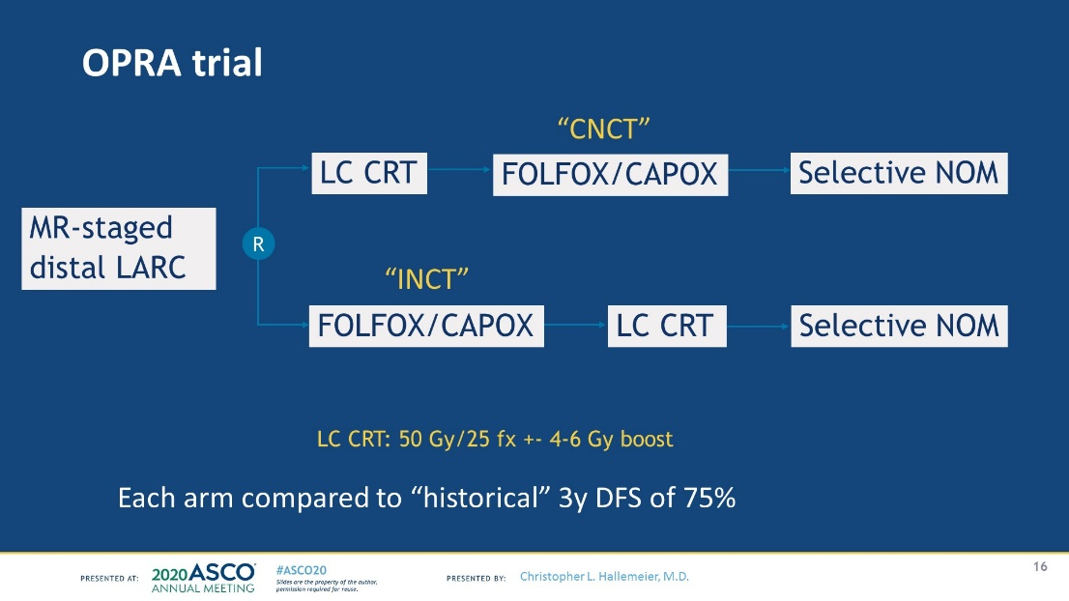
71% INCT
76% CNCT
Aguilar JG, JCO 2022

Slide 33
Complete (clinical) response in rectal cancer: when to assess it
Pooled analysis of 3085 individual patient data enrolled in 7 international randomized trials: CAO/ARO/AIO-94, EORTC22921, FFCD9203, ACCORD12/0405, CAO-AROAIO-04, TROG 01.04 and INTERACT-LEADER
Gambacorta MA …. Valentini V, Radiother & Oncol 2020

Slide 34
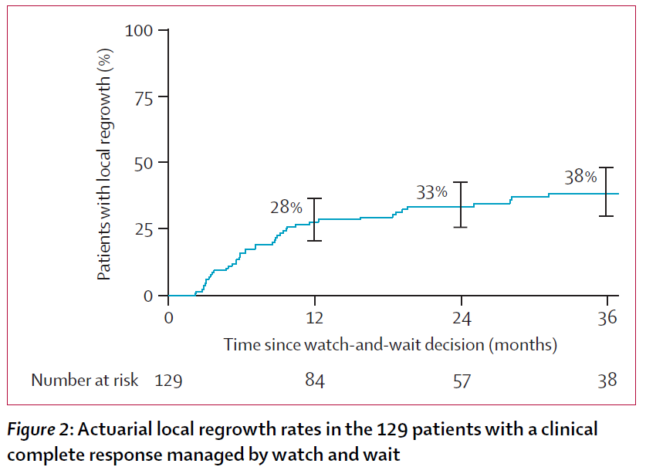
Complete (clinical) response in rectal cancer: risk of disease regrowth
Renehan AG, Lancet Oncol 2016

